Slide 1
Stress Management Strategies
Presented by: Kayla Newkirk and Janay Jones
Clinical Mental Health Interns

Slide 2
Disclaimer
This presentation is not to replace any medical or mental health treatment, assessment, or diagnoses.
This is for informational use only

Slide 3
Agenda
Learn about different types of stress
Identify signs and symptoms
Ways to manage

Slide 4
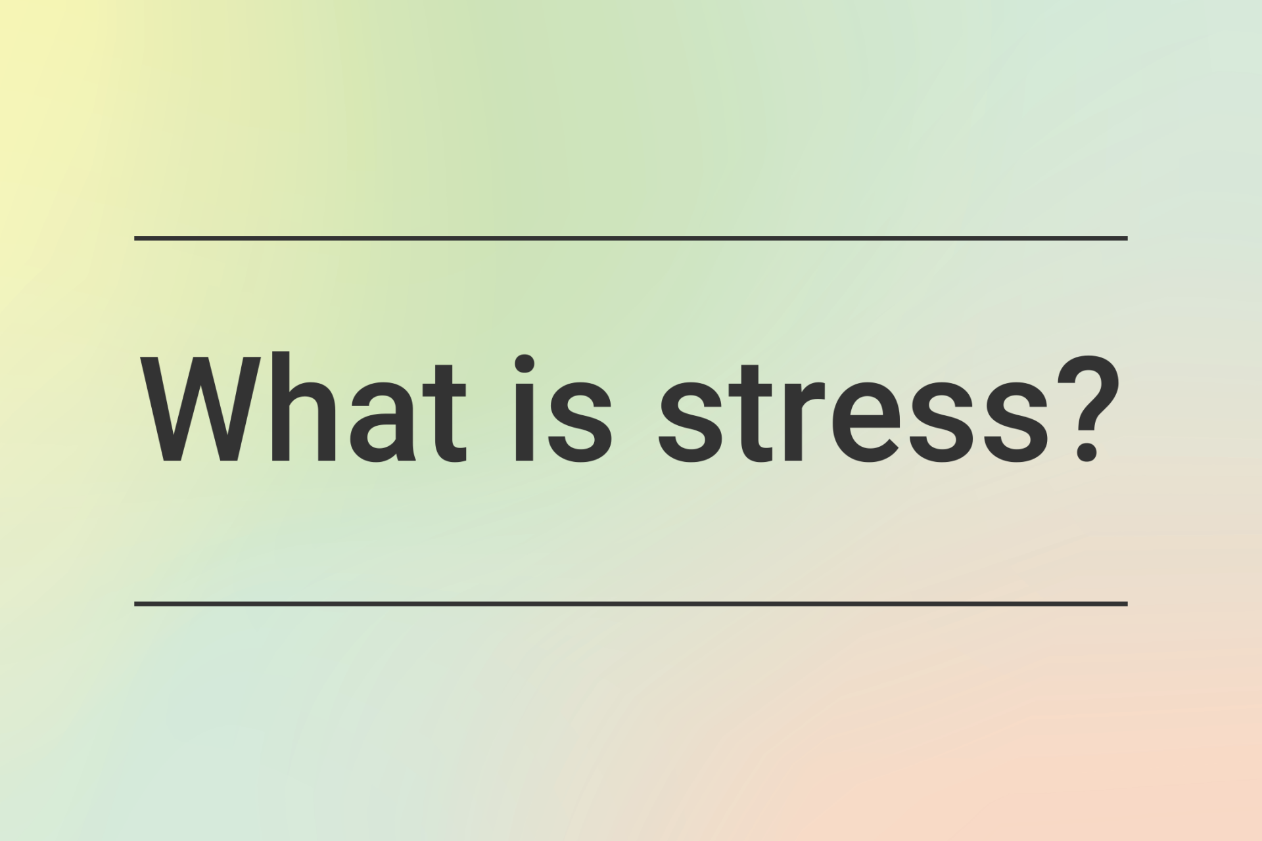
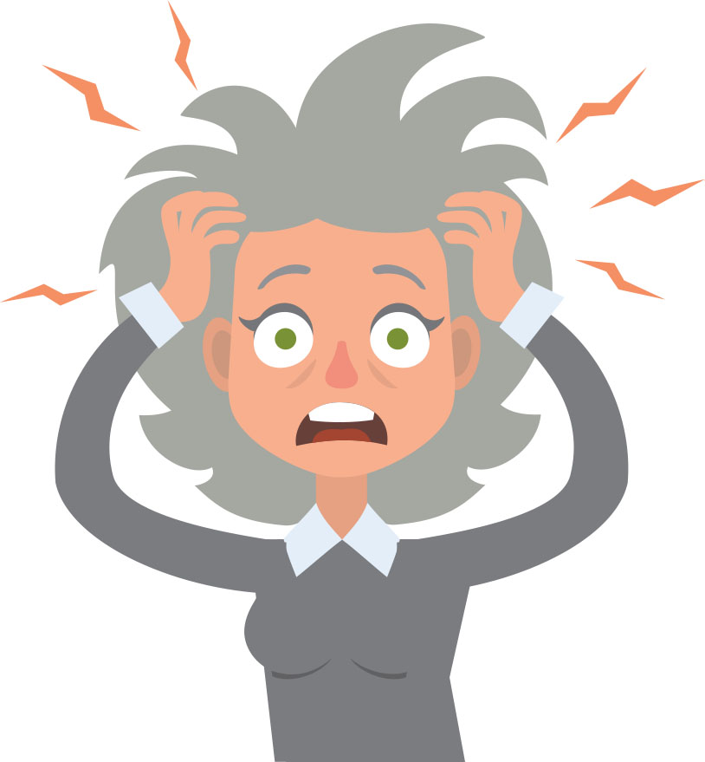
Stress can be described as a physical, emotional, or mental factor that causes bodily or mental tension.
It can come from any situation or thought that makes you feel frustrated, angry, or nervous.

Slide 5
Facts About Stress
Stress can be acute or chronic
Stress affects everyone, but can look and feel different at an individual level
Stress is a normal part of life
Not all stress is bad
Long-term stress can impact your health
The good news? Stress can be successfully managed!

Slide 6
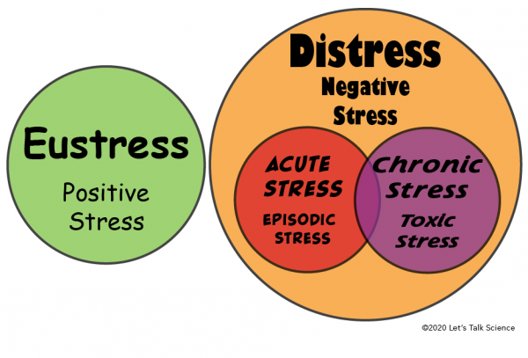
Positive Stress versus Negative Stress
Which do you experience more?

Slide 7
Positive Stress versus Negative Stress
Positive stress (Eustress) is always mild or moderate.
It results in to positive effects including improved creativity,learning, efficiency at work, and a higher sense of self-esteem.
Negative Stress (Distress) is usually severe and is out of one’s control.
It is typically known for the physical and mental signs and symptoms

Slide 8
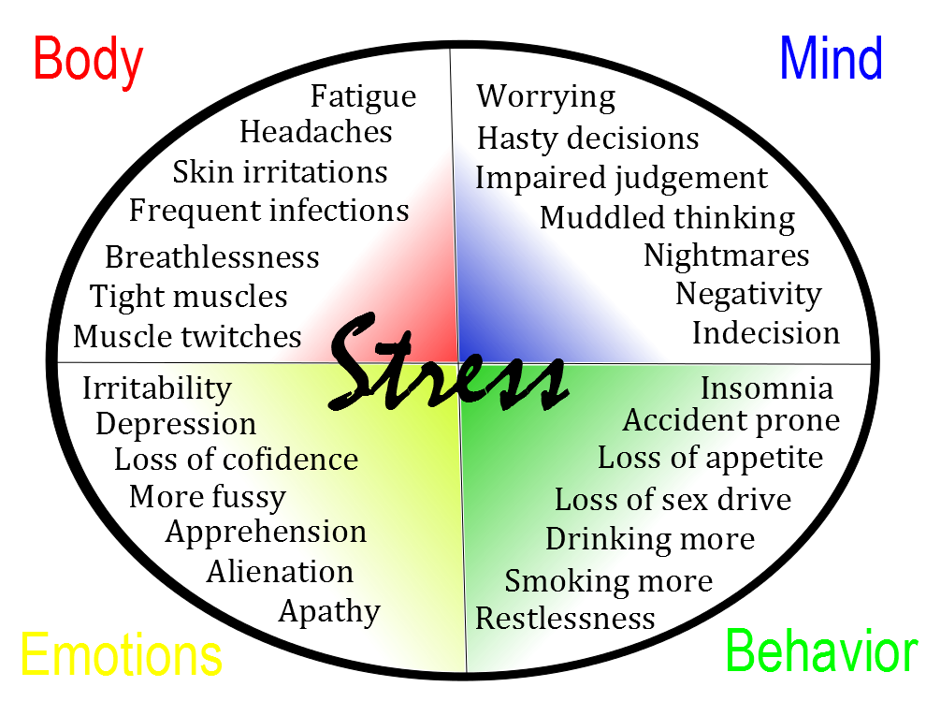
How Does Stress Impact Me?
These are some of the emotional, behavioral, physical, and mental symptoms that can occur from distress

Slide 9
Types of Stress
Acute Stress
Episodic Stress
Chronic Stress
initial reaction after trauma and distress, which can last for a few weeks
This often occurs after a traumatic event
Increased risk for those with an existing mental illness or previous episodes of Acute Stress
Also known as frequent or recurring
This typically impacts physical and mental health, increasing risk for heart attack, stroke, diabetes, and more.
High levels of stress over a long period of time
Higher health risks occur when this type of stress is present for longer periods of time

Slide 11
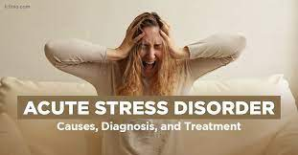
What is Acute Stress?

Slide 12
Symptoms of Acute Stress
Symptoms may include:
depression
anxiety
sleeplessness
lack of emotion
trouble concentrating
sensitivity to triggers
irritability
disassociation
avoidance
chest pain
nausea

Slide 13
What Causes Acute Stress ?
Examples of events that could lead to acute distress include natural disasters, combat, a history of trauma, serious accidents, sudden death of a loved one, and assault or abuse.

Slide 14
Treating Acute Stress
Treatment options include:
Trauma-Focused Cognitive Behavioral Psychotherapy to help adjust thought patterns and behaviors from the unwanted trauma
Short-term use of medication
Focus on reducing or management of symptoms

Slide 15
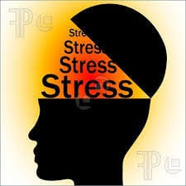
What is Episodic Stress?

Slide 16
Symptoms of Episodic Stress
Symptoms may include:
Anxiety
Depression
Digestive problems
Higher blood sugar
Higher blood pressure
Increased cholesterol
Weight gain

Slide 17
What Causes Episodic Stress ?
Can occur due to interpersonal life difficulties, demanding job, taking on too much responsibility, or interpreting situations in catastrophic ways

Slide 18
Treating Episodic Stress
Treatment options include:
Cognitive-Behavioral Therapy to assist with anxiety and worry to lessen catastrophizing
Lifestyle changes
Medications

Slide 19
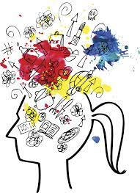
What is Chronic Stress?

Slide 20
Symptoms of Chronic Stress
Symptoms may include:
Aches and pains
Insomnia or sleepiness
Low energy
Unfocused or cloudy thinking
Increased drug or alcohol use
Change in appetite
Changes in social behavior such as staying in more often

Slide 21
What Causes Chronic Stress ?
Examples may include:
Poverty
Dysfunctional relationships
Dissatisfying job or career
Feeling pressure long-term
Long-term worries
Feeling loss of control over a situation, including the outcome
Feeling overwhelmed
Experiencing discrimination, hate, or abuse

Slide 22
Treating Chronic Stress
Treatment options include:
Exercising
Eating healthy food
Learning new skills such as time management techniques
Setting realistic goals
Getting more sleep
Building stress reduction skills
Learning and practicing mindfulness skills
Making time for self-care or leisure activities

Slide 23
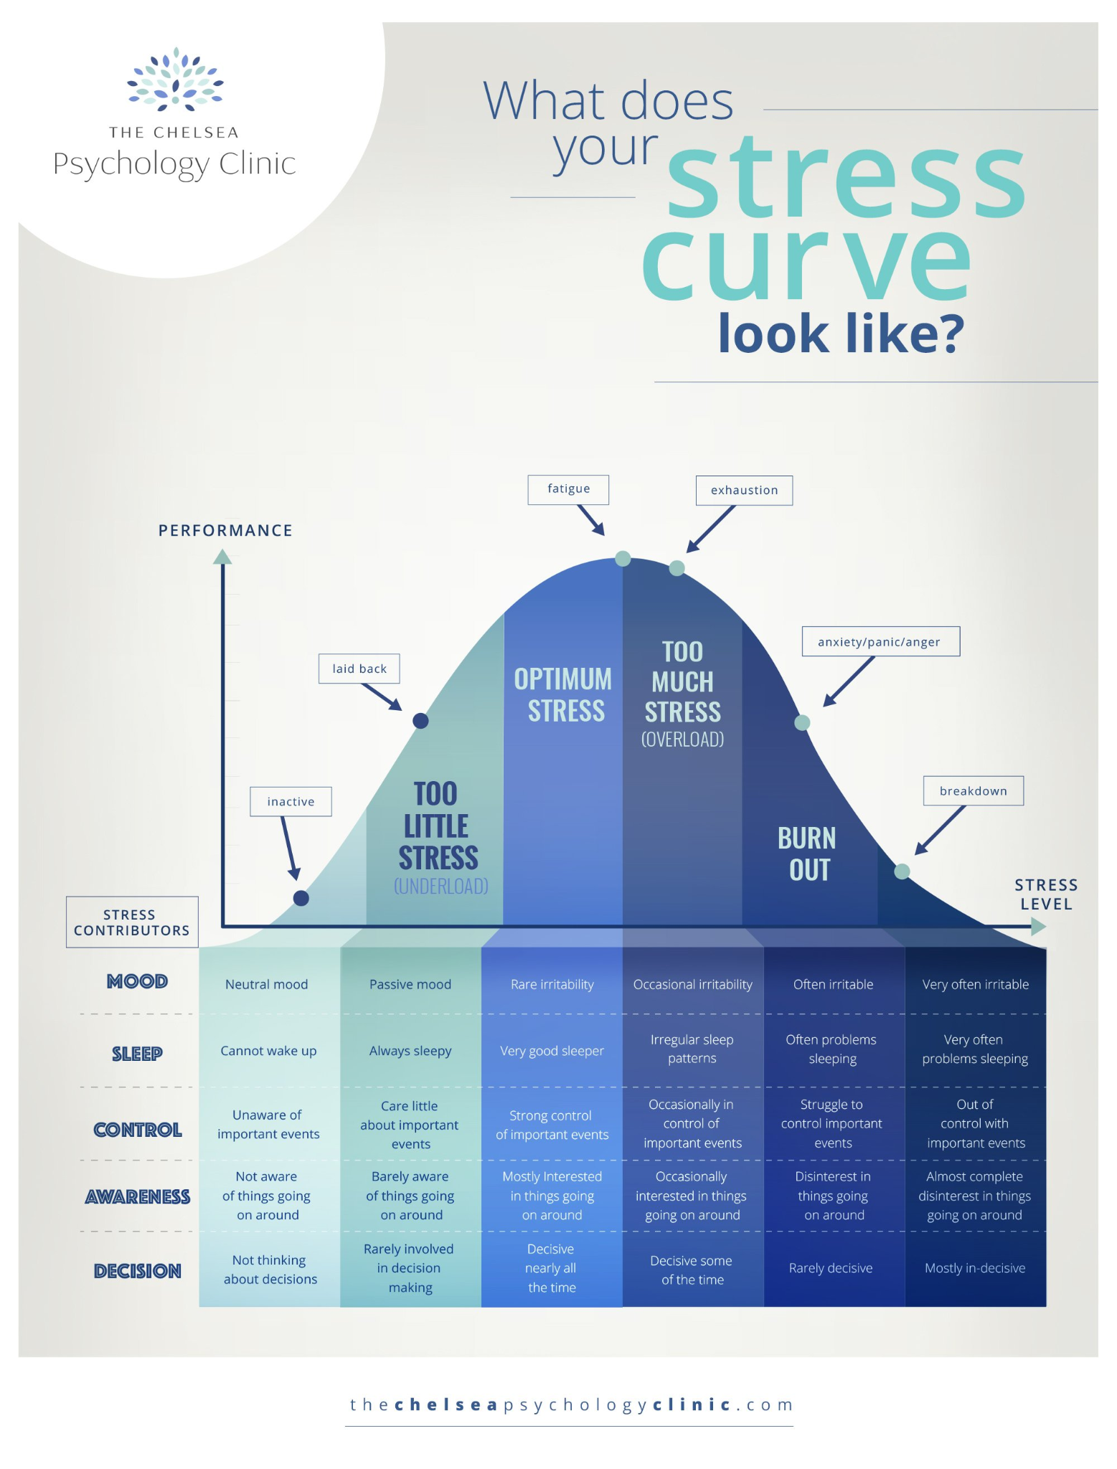
What does your stress curve look like?

Slide 24
Stress Management Skills

Slide 25
How to Manage Stress In-the-Moment
Try affirmations such as “I am in charge of my life” or “I am doing well one step at a time” or maybe something that feels better to you!
Try “parking” your thoughts that pop up that become overwhelming by writing them down on a piece of paper to stay on task
Try a quick meditation technique or body scan to let go of any unwanted stress within the body and mind
Take a moment to stretch your body, go for a short walk, or write down how you are feeling
What else helps you manage your stress?

Slide 26
Using Strengths to Approach Stress
Appreciate beauty and excellence? Go outside and enjoy beautiful scenery for 10 minutes
Love to laugh? Watch a comedy or crack a couple of jokes
Are you all about self-regulation? Try pausing and count a few breaths throughout the day
Is self-worth something you highly value? Allow yourself to be human and make mistakes throughout the day
What are your strengths? Can you think of a way to boost your stress management with your strengths?

Slide 27
Time Management Techniques
Use an online calendar to share your schedule with your family or partner
Grab a planner for organization if paper and pen are your preferred method!
Create a list at the beginning of each day and note which items are the most important to do first
Combine tasks for time efficiency when planning ahead
Eliminate time-wasting activities and procrastination
Reward yourself when a task if done!
Keep a time log to figure out how long it takes to complete each task
Creating a Realistic Schedule
Notes:
(These don’t have designer IDs since they were based off the default master slides already in the deck.

Slide 28
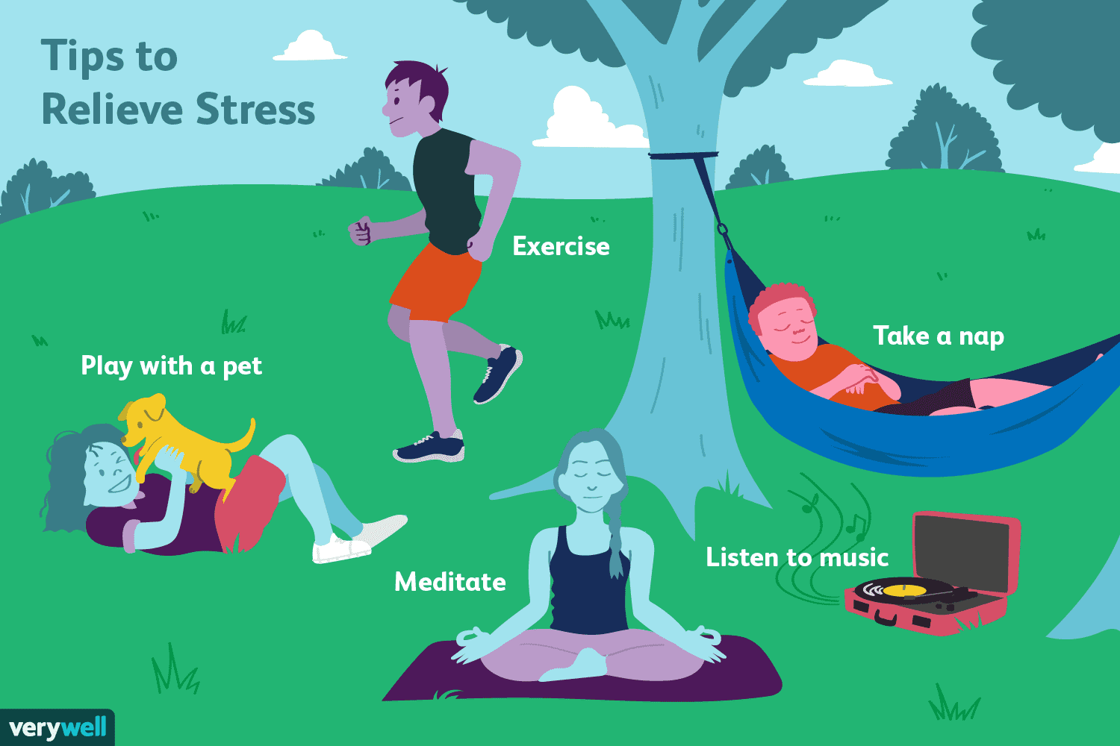
Stress Reduction Tips
Write down 1-3 things each day that you are grateful for
Expect positive outcomes in new situations
Take a 10 minute break to do something you enjoy when you become stressed
Eat healthy food, drink enough water during the day, exercise, and sleep well
Connect with social support such as family and friends
Keep a journal to release how you feel through words, colors, or doodles

Slide 29
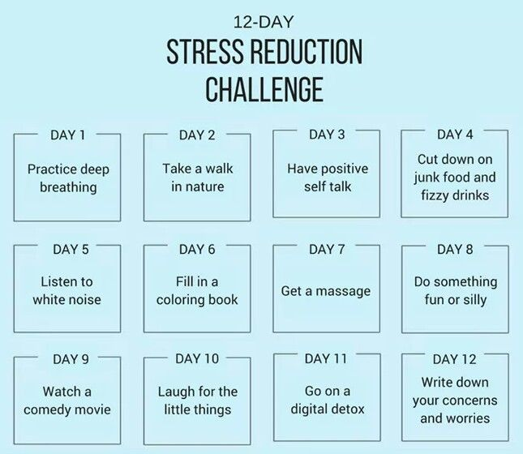
Are You Up for the Challenge?
Want to try something else for the challenge? Consider…
A deep breathing exercise
Plan a healthy meal
Ask for help
Plan a night with friends
Compliment someone
Do something outside
Say no to something
Adopt a new habit
Take 10 minutes to read or journal
Listen to your favorite music
Drink water
Go for a walk

Slide 30
Looking for other ways to combat your stress?
Try these local resources out!

Slide 31
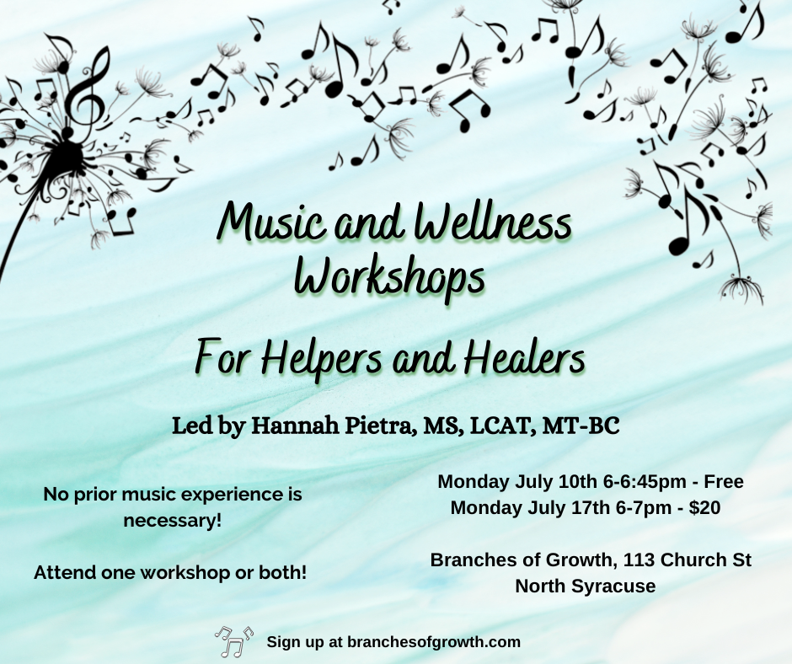
This is a wellness workshop for healers and helpers (teachers, therapists, doctors, nurses, caregivers, coaches, mentors, doulas, etc.) to take time for self care and restoration.
These music related exercises may include: music and art making, music assisted relaxation, active music listening such as lyric analysis, song discussions, guided imagery, meditations, and songwriting.
The therapeutic use of music can be beneficial for stress management, resiliency, creative exploration, and burnout prevention.

Slide 32
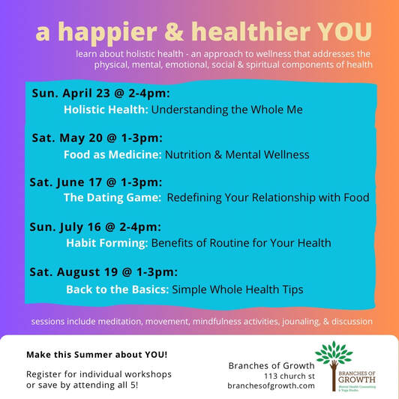

Slide 33
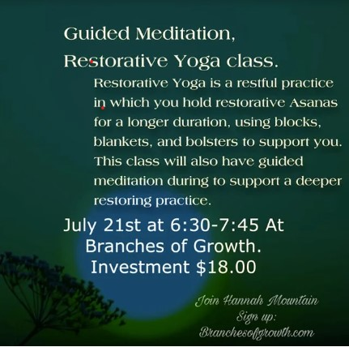

Slide 34
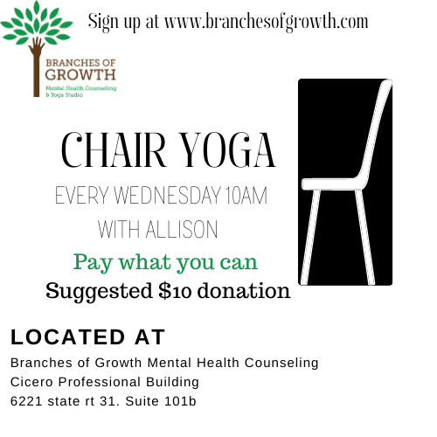
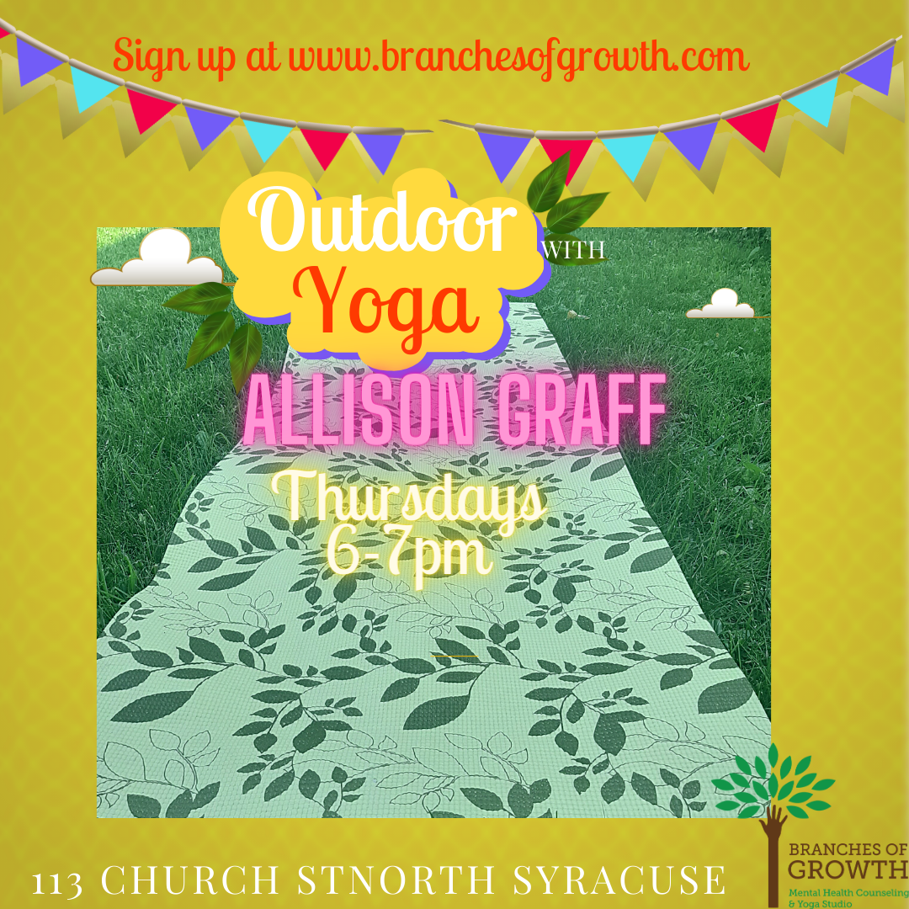

Slide 35
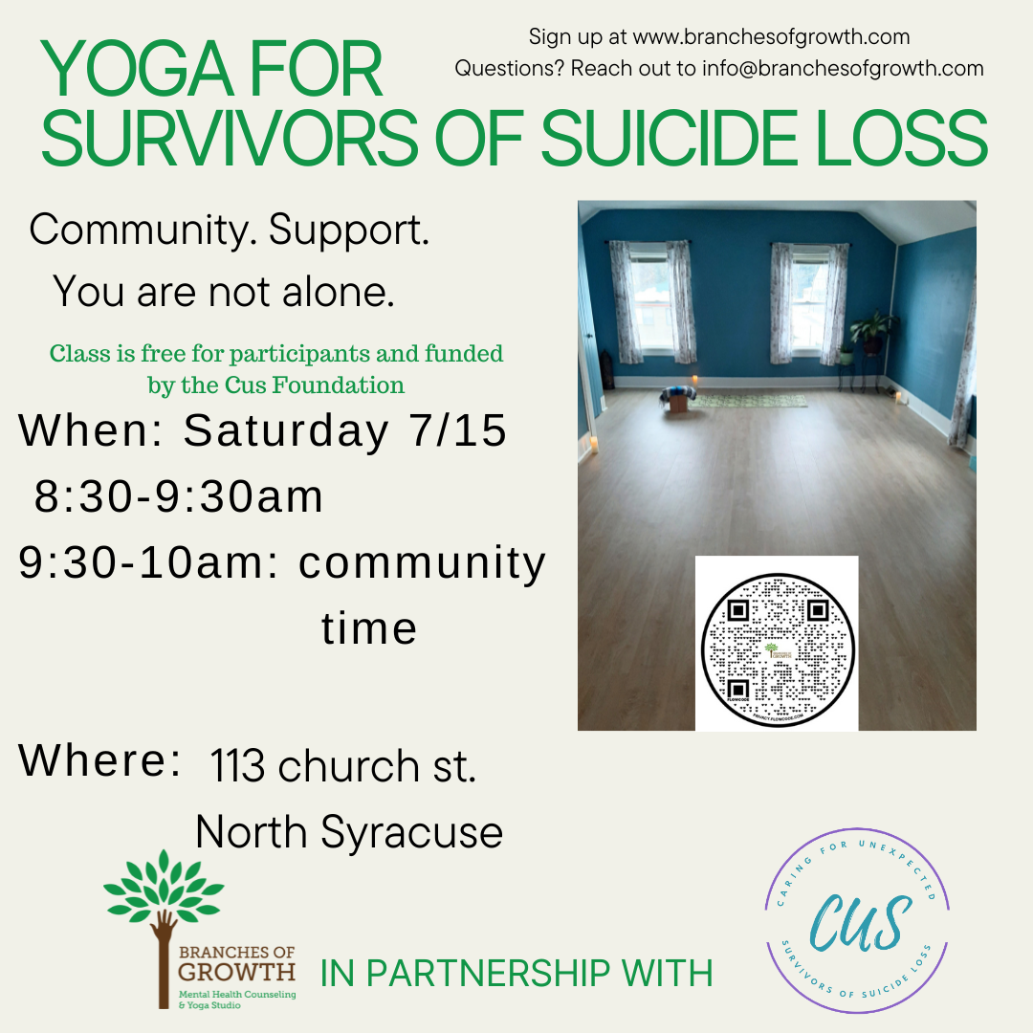

Slide 36
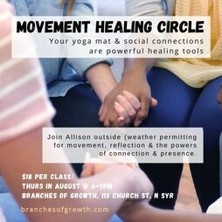
Thursdays Movement Healing Circle with Allison 6-7pm
August 3, 10, 17, 24, and 31st!
Your yoga mat and the companionship of others are powerfulhealing tools. Join Allison outside (weather permitting) for movement, written reflection, and the healing power of presence.

Slide 37
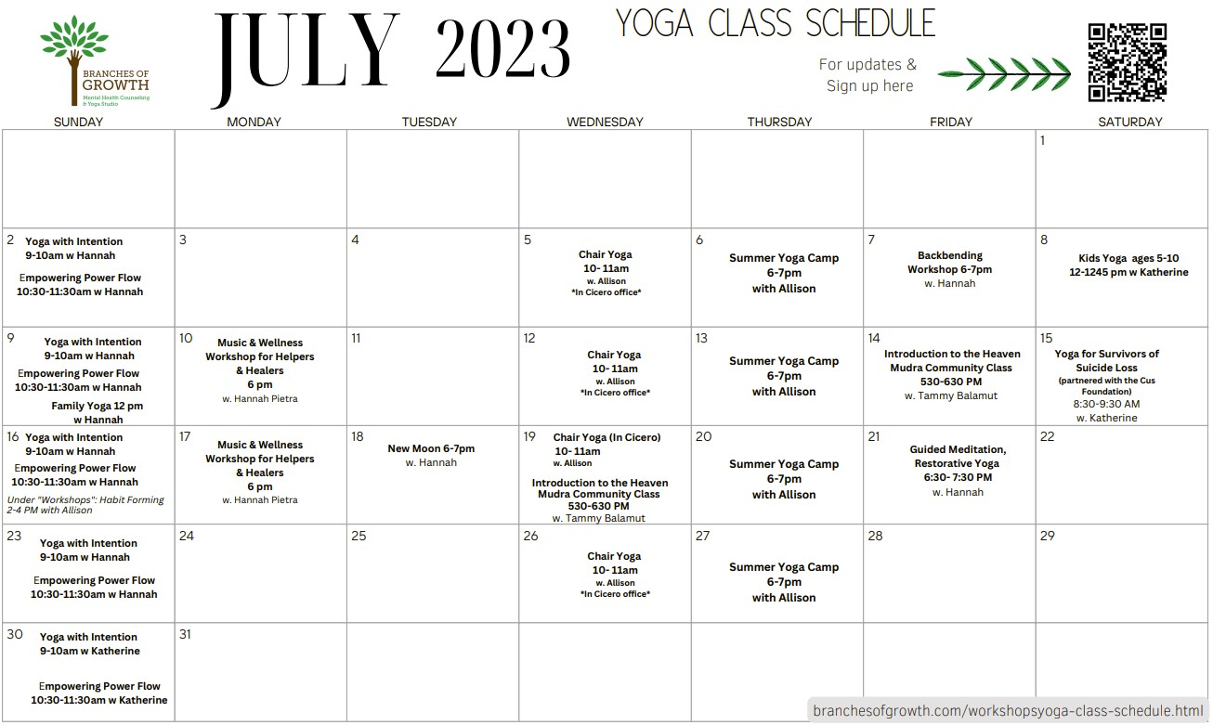

Slide 38
Time to recap
What did you learn today?
How might this help you now or in the future?

Slide 39
What questions do you have?

Slide 40
Thank you!
Website: branchesofgrowth.com
Email: info@branchesofgrowth.com
Social Media: branchesofgrowth

Slide 41
References
https://www.healthshots.com/mind/mental-health/10-stress-management-techniques-to-ease-your-life/
https://www.penncares.org/event/stress-management-11-9-22/
https://www.psychologytoday.com/us/blog/what-matters-most/201701/10-new-strategies-stress-management
Childs, E., & de Wit, H. (2014). Regular exercise is associated with emotional resilience to acute stress in healthy adults. Frontiers in physiology, 5, 161.
Cohen, S., Janicki-Deverts, D., & Miller, G. E. (2007). Psychological stress and disease. JAMA, 298(14), 1685-1687. doi:10.1001/jama.298.14.1685
Cohen, S., Kamarck, T., & Mermelstein, R. (1983). A global measure of perceived stress. Journal of health and social behavior, 385-396.
Janssen, M., Heerkens, Y., Kuijer, W., van der Heijden, B., & Engels, J. (2018). Effects of Mindfulness-Based Stress Reduction on employees' mental health: A systematic review. PloS one, 13(1), e0191332.
Kocalevent, R. D., Hinz, A., & Brähler, E. (2011). Standardization of a screening instrument (PHQ-15) for somatization syndromes in the general population. BMC psychiatry, 11(1), 1-7. doi: 10.1186/1471-244X-11-91
Lazarus, R. S. (1999). Stress and emotion: A new synthesis. Springer Publishing Company.
Ma, X., Yue, Z. Q., Gong, Z. Q., Zhang, H., Duan, N. Y., Shi, Y. T., ... & Li, Y. F. (2017). The effect of diaphragmatic breathing on attention, negative affect and stress in healthy adults. Frontiers in psychology, 8, 874.
Marques, A. H., Silverman, M. N., & Sternberg, E. M. (2009). Evaluation of stress systems by applying noninvasive methodologies: measurements of neuroimmune biomarkers in the sweat, heart rate variability and salivary cortisol. Neuroimmunomodulation, 16(2), 102-110. doi: 10.1159/000180266
Mayo Clinic (2020). Stress management. Mayo Foundation for Medical Education and Research.
McEwen, B. S. (2008). Central effects of stress hormones in health and disease: Understanding the protective and damaging effects of stress and stress mediators. European Journal of Pharmacology, 583(2-3), 174-185. doi:10.1016/j.ejphar.2007.11.071
Sonnentag, S., & Frese, M. (2012). Stress in organizations. In N. W. Schmitt & S. Highhouse (Eds.), Comprehensive handbook of psychology: Vol. 12. Industrial and organizational psychology (pp. 560-592). Wiley.
Yau, Y. H., & Potenza, M. N. (2013). Stress and eating behaviors. Minerva endocrinologica, 38(3), 255.

Slide 42
References
chrome-extension://efaidnbmnnnibpcajpcglclefindmkaj/https://www.nimh.nih.gov/sites/default/files/documents/health/publications/stress/19-mh-8109-5-things-stress.pdf
https://www.rescueremedy.com/en-us/explore/rescue-blog/2018/10-facts-about-stress-you-may-not-know/
https://www.healthline.com/health/facts-about-stress
https://ada.com/conditions/acute-stress-disorder/
https://www.beamlocal.com/how-stress-affects-your-work-plus-ways-to-manage-stress/
https://ada.com/conditions/acute-stress-disorder/
https://www.thechelseapsychologyclinic.com/blog/see-stress-curve/
https://www.sutterhealth.org/health/young-adults/emotions-mental-health/stress-time-management

